Slide 1

Unforgettable trips start with Airbnb

Slide 2
Airbnb
Airbnb stands for Air–bed and breakfast.
Airbnb is an online community marketplace, which act as an intermediary between those who want to rent out space and those who are looking for space to rent.
Since it began operating in 2008, Airbnb has shaken up the hospitality industry, and reports are that it could soon be valued at over $20 billion.

Slide 3
Data information from Airbnb
From Airbnb, I was able to get data of 300 top-rated guest homes
Countries = USA, Korea, France
Location
Home type
Price
Max guest
Reviews
Home summary
Amenities

Slide 4
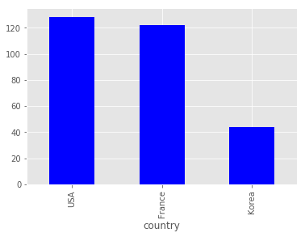
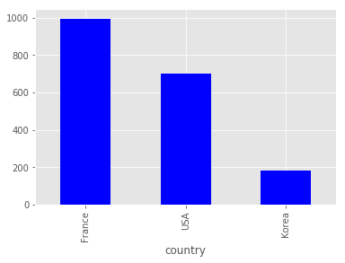
Comparing price each countries
Average Price:
USA = $128
France = $122
Korea = $44
highest Price:
USA = $ 700
France = $ 995
Korea = $ 182
Bar chart shows average and highest guest home price of Korea is more affordable compare to USA and France

Slide 5
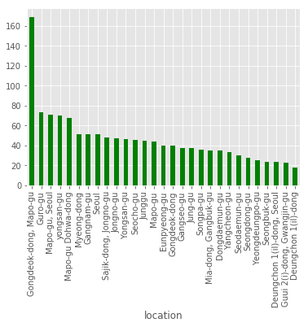
This bar graph compares average price between different area in Korea
Price range from
$18 to $169
29 different locations

Slide 6
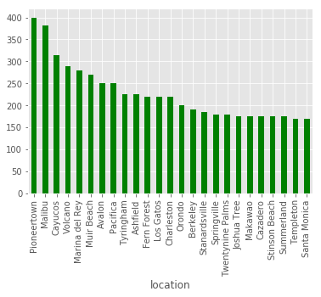
This bar graph compares average price between different area in USA
Price range from
$169 to $400
25 out of 64 different locations

Slide 7
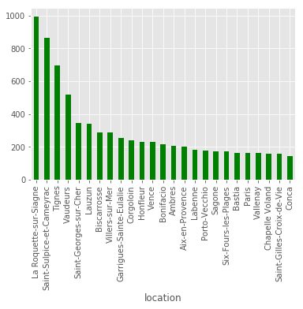
This bar graph compares average price between different area in France
Price range from
$145 to $995
25 out of 119 different locations

Slide 8
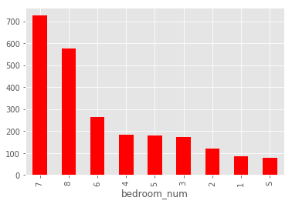
Price and Bedroom
Bar graph compares average price with different number of bedrooms
Price range from
$80 to $725
725.250000 = 7 575.000000 = 8 263.600000 = 6 182.437500 = 4 181.400000 = 5 173.678571 = 3 119.279570 = 2 86.675057 = 1 80.094828 = S

Slide 9
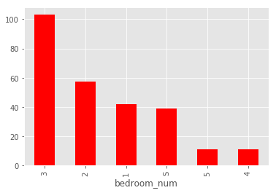
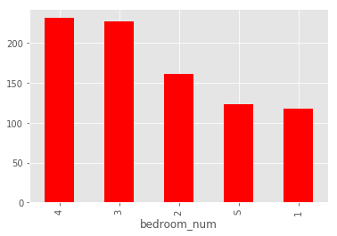

Korea
USA
France
bedroom_num
1 | 100
2 | 35
3 | 14
4 | 12
5 | 4
6 | 5
7 | 4
8 | 1
S | 28
bedroom_num
1 | 136
2 | 22
3 | 5
4 | 1
5 | 1
S | 42
bedroom_num
1 | 201
2 | 36
3 | 9
4 | 3
S | 46

Slide 10
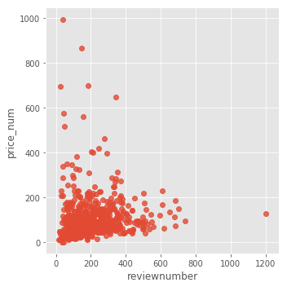
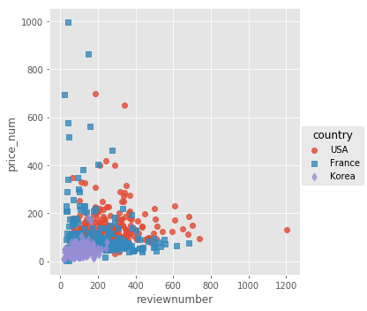
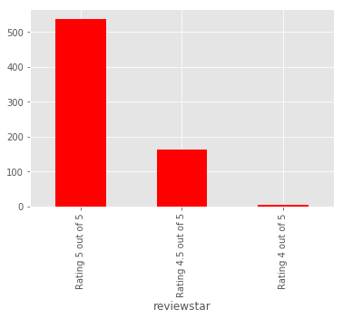
Price and Customer review
Since data is about 300 top-rated guest home, I could find out that most homes have review rate 5 out of 5
There are many customer reviews for home price under $300 but number of reviews for each guest homes stays under 600 customer reviews
There is no significant correlation between number of reviews and price

Slide 11
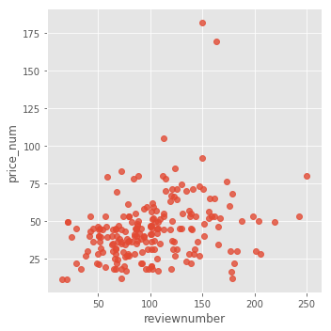
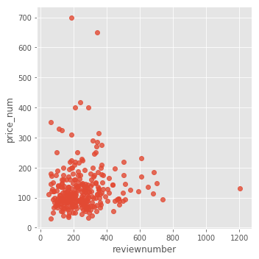
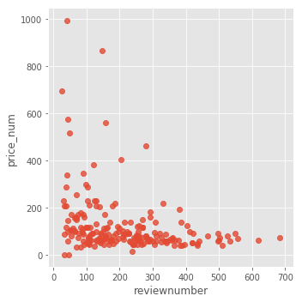
Korea
USA
France

